Slide 1
GANaTantra : GENERATIVE ADVERSARIAL NETWORK ARCHITECTURE FOR MUSIC SYNTHESIS
BATCH 8:
620244-SHRIKAR VENKATA TAMIRISA
620101-ABBANABOINA MANJUNADH
620141-GUJJARU MANOJ SATHWIK
SUPERVISED BY: DR.THULASYA NAIK

Slide 2

Dataset and Preprocessing
Erk subset of KernScores Essen Deutschl dataset, consists of 1700 German piano tunes.
music21 library for .krn file processing
Melodies with acceptable duration filtered, transposed and encoded into string format with delimiters.
Mapping of string characters to int created, training sequences consisting of input and target integers generated.

Slide 3
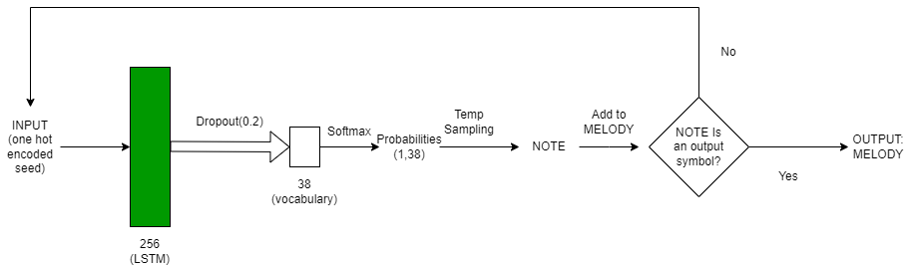
Trials using LSTM

Slide 4
Summary
Adam optimization with 0.001 learning rate
Trained for 50 epochs.
Loss function: sparse categorical crossentropy.
Used T4 GPU for training.
Temperature sampling used to control creativity of the generative model.
Erratic behaviour: different melody lengths for each output.
When forced to produce melody of a given length, seems unnatural.
Minimalist melodies with low complexity.

Slide 5
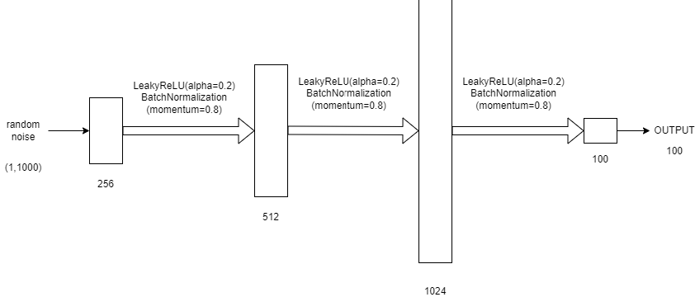
Trials using GANs - Generator

Slide 6
Input: An array of 1000 random numbers normally distributed between 0 and 1.
Output: An array of 100 numbers ranging from -1 to +1.
Scaled back to integers by using the formula:
pred_notes = [x * (n_vocab / 2) + (n_vocab / 2) for x in predictions[0]]
Using a map of integers to notes, predictions converted into notes (array of strings), which is then converted into midi files with the help of music21 library.

Slide 7
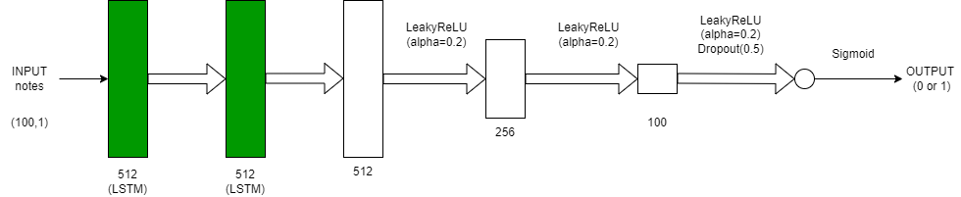
Trials using GANs - Discriminator

Slide 8
Using a note_to_int mapping, dataset notes are converted to integers.
These integers are normalized between -1 and +1 by using the formula:
network_input = (network_input - float(n_vocab) / 2) / (float(n_vocab) / 2)
This matches with the output of the generator (which is also normalized between -1 and +1 as seen earlier)
Optimizer: Adam (learning rate = 0.0002, beta_1 = 0.5)
Loss function: Binary Crossentropy (binary classification task)

Slide 9
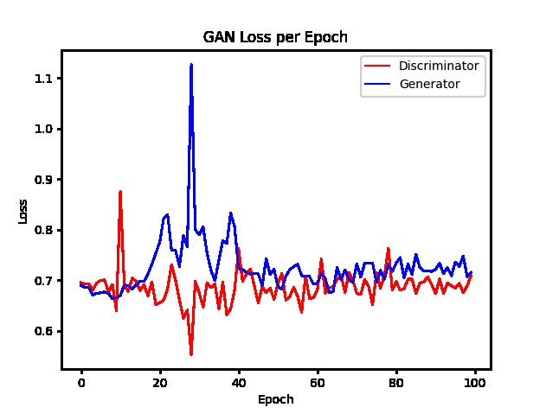
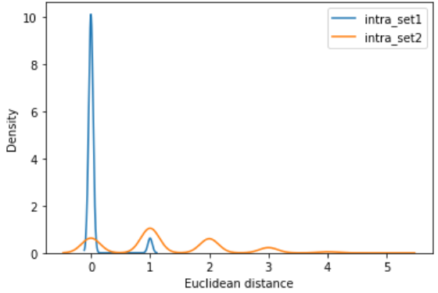
Analysis
Generator Loss: 0.715289
Discriminator Loss: 0.709023
High possibility of mode collapse!

Slide 10
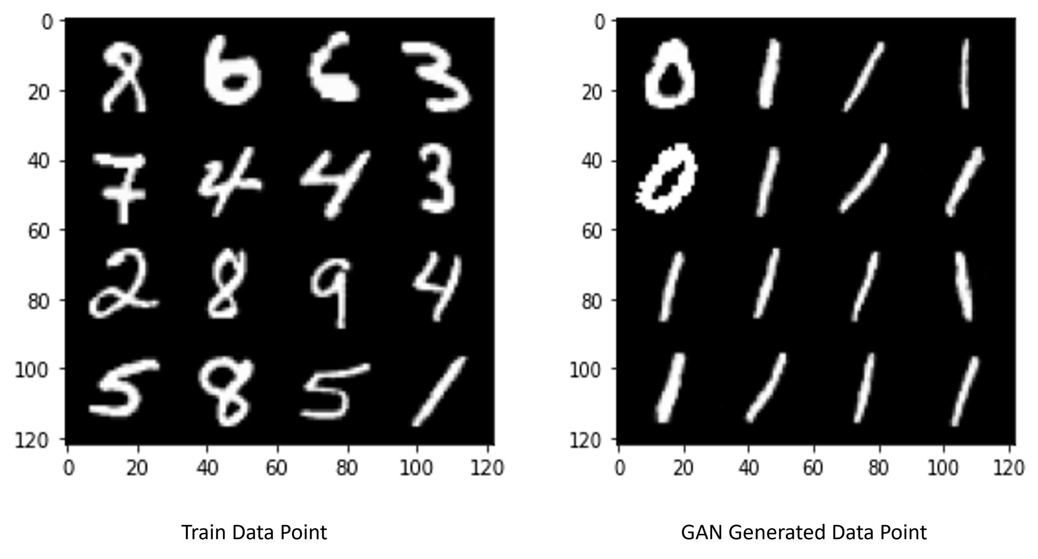
Mode Collapse in GANs
Generator produces limited varieties of outputs, failing to capture the entire diversity of the training data.
Main causes:
Insufficient Model Capacity
Training Instability
Lack of Diversity in Training Data
Loss Function Issues
Discriminator overfitting

Slide 11
Solving The Problem
We employed 3 strategies to beat mode collapse:
Wasserstein GAN
Random noise injection
Regularization

Slide 12
Wasserstein Loss Function
The Wasserstein loss function seeks to increase the gap between the scores for real and generated dataset.
According to Arjovsky et al,
Critic Loss = [average critic score on real data] – [average critic score on fake data]
Generator Loss = -[average critic score on fake data]
In the case of the generator, a larger score from the critic will result in a smaller loss for the generator, encouraging the critic to output larger scores for fake data.
In the case of the critic, a larger score for real data results in a larger resulting loss for the critic, penalizing the model. This encourages the critic to output smaller scores for real data.

Slide 13

We can reduce this logic to:
> 0 for fake
< 0 for real
To keep the gradient in the correct direction, i.e. minimizing loss,
Wasserstein Loss(Real Images) = 1 * Average Predicted Score
Wasserstein Loss(Fake Images) = -1 * Average Predicted Score
So, it essentially becomes: Wasserstein Loss = Label * Average Critic Score

Slide 14
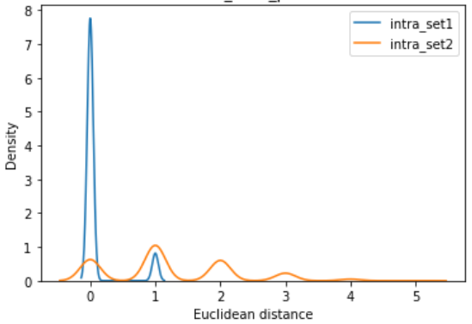
It has been observed that this loss function:
Focuses on pushing the distributions of real and generated data closer together. Directly minimizes the distance between the generated and real distributions.
Smoothens gradient flow, lower chances of “vanishing gradient” problem.
Stabilizes training.
Also called “Earth Mover’s Distance” in mathematics.

Slide 15
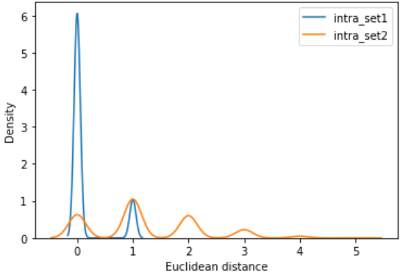
Random Noise Injection
Injecting noise facilitates exploration of a broader spectrum of realistic outputs, mitigating the risk of memorizing specific inputs.
Increased model capacity
Prevents overfitting and overconfidence.
More robust to small perturbations in the input space, more stable training dynamics.
Gaussian noise with standard deviation of 0.1 added after every layer of generator and discriminator.

Slide 16
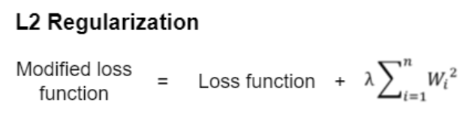
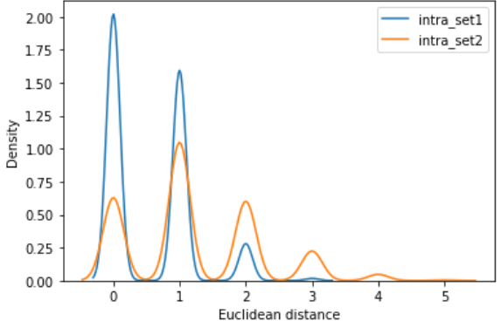
Regularization
Prevent overfitting in discriminator.
Encourage generator to learn more general and discriminative features.
Keeps the weights low. Neural networks with small weight values are not much sensitive to the noise present in the input data.
L2 Kernel Regularizer with lambda=0.1 used in both generator and discriminator.

Slide 17
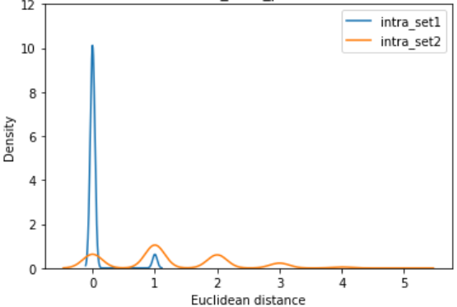
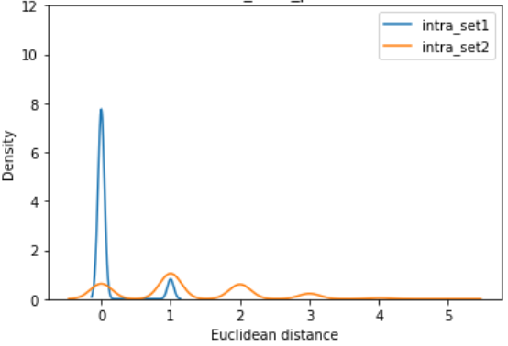
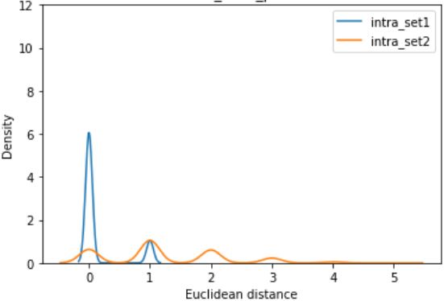

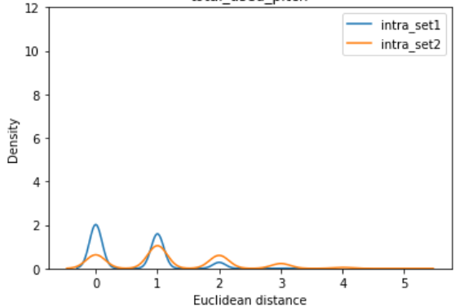

Summary

Slide 18
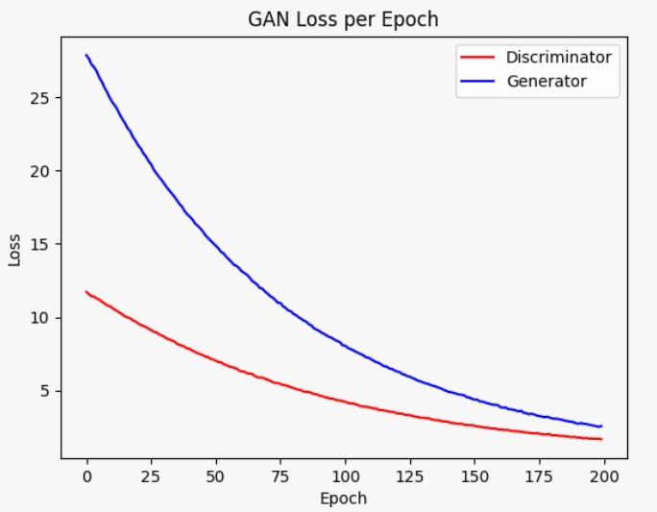
G loss : 2.56
D loss: 1.66

Slide 19

Results

Slide 20
References
[1] Hochreiter, Sepp & Schmidhuber, Jürgen. (1997). Long Short-term Memory. Neural computation. 9. 1735-80. 10.1162/neco.1997.9.8.1735.
[2] Ronald J. Williams and David Zipser. 1995. Gradient-based learning algorithms for recurrent networks and their computational complexity. Backpropagation: theory, architectures, and applications. L. Erlbaum Associates Inc., USA, 433–486.
[3] Robinson, Tony & Fallside, F.. (1987). The utility driven dynamic error propagation network.
[4] Sepp Hochreiter. Untersuchungen zu dynamischen neuronalen Netzen. Diploma thesis, TU Munich, 1991
[5] Goodfellow, I., Pouget-Abadie, J., Mirza, M., Xu, B., Warde-Farley, D., Ozair, S., …Bengio, Y. (2014). Generative adversarial nets. In Advances in neural information processing systems (pp. 2672–2680).
[6] Arjovsky, M., Chintala, S. and Bottou, L., 2017, July. Wasserstein generative adversarial networks. In International conference on machine learning (pp. 214-223). PMLR.
[7] Mitzenmacher, Michael and Sean Owen. 2000. Estimating Resemblance of MIDI Documents. Harvard Computer Science Group Technical Report TR-06-00.
[8] Yang, LC., Lerch, A. On the evaluation of generative models in music. Neural Comput & Applic 32, 4773–4784 (2020).
[9] G. Li, S. Ding and Y. Li, "Novel LSTM-GAN Based Music Generation," 2021 13th International Conference on Wireless Communications and Signal Processing (WCSP), Changsha, China, 2021, pp. 1-6, doi: 10.1109/WCSP52459.2021.9613311.
[10] Feng, R., Zhao, D. and Zha, Z., 2020. On noise injection in generative adversarial networks. arXiv preprint arXiv:2006.05891.
[11] Lee, M. and Seok, J., 2020. Regularization methods for generative adversarial networks: An overview of recent studies. arXiv preprint arXiv:2005.09165.

Slide 21
THANK YOU!
"Music is science more than art, and it is the main code of the universe".
~Vangelis

